Slide 1

Global Positioning Systems

Slide 2
The Global Positioning System (GPS), originally NAVSTAR GPS, is a satellite-based radionavigation system owned by the United States government and operated by the United States Space Force.
It is a technology by which the location of an object, its velocity, direction and time can be known precisely at any time, irrespective of day/night, weather, or the configuration of object.
Notes:
The Global Positioning System (GPS), originally Navstar GPS, is a satellite-based radionavigation system owned by the United States government and operated by the United States Space Force.
It is a technology by which the location of an object, its velocity, direction, altitude and time can be known precisely at any time, irrespective of day/night, weather, or the configuration of the object.

Slide 3
History of GPS
Introduced by the United States Department of Defence, 1987
Originally NAVSTAR - Navigation System with Time and Ranging
Constellation of 24 satellites became operational in 1993
Launched civilian use in 1980s
Two levels of service
Standard Positioning Service (SPS)
Precise Positioning Service (PPS)
Notes:
GPS, originally named NAVSTAR - Navigation System with Time and Ranging was introduced by the United States Department of Defence in 1987. The full constellation of 24 satellites became operational in 1994 and was later launched for civilian use in the 1980s.
Today, GPS is a multi-use, space-based radionavigation system owned by the US Government and operated by the United States Air Force to meet national defense, homeland security, civil, commercial, and scientific needs.
GPS currently provides two levels of service: Standard Positioning Service (SPS) which uses the coarse acquisition (C/A) code on the L1 frequency, and Precise Positioning Service (PPS) which uses the P(Y) code on both the L1 and L2 frequencies. Access to the PPS is restricted to US Armed Forces, US Federal agencies, and selected allied armed forces and governments. The SPS is available to all users on a continuous, worldwide basis, free of any direct user charges.

Slide 4
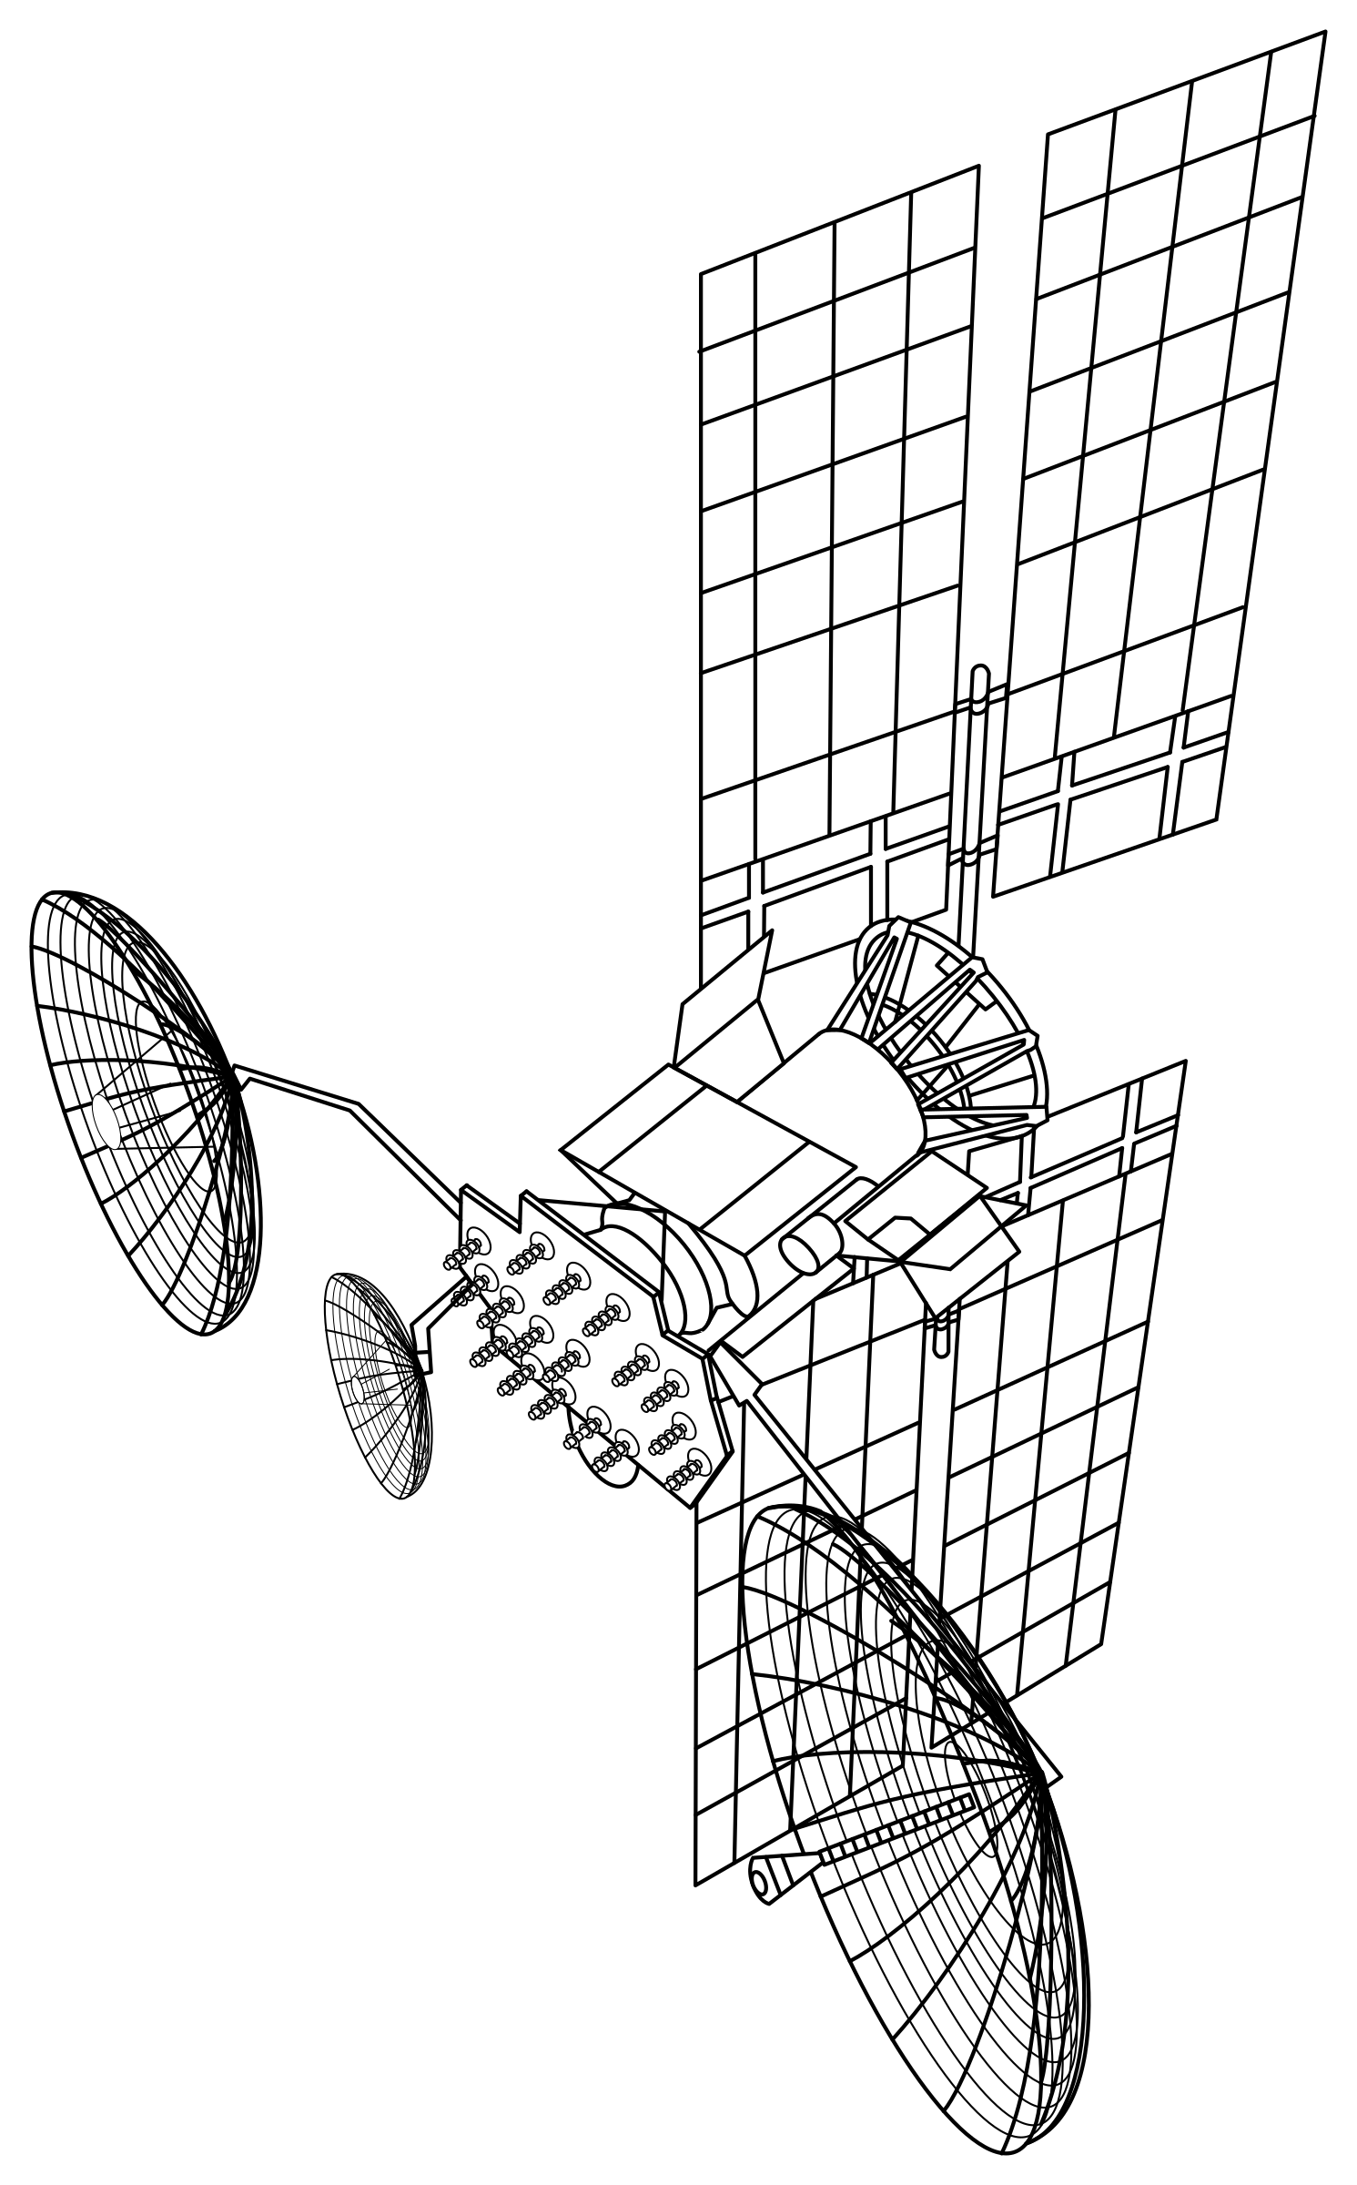
Space Segment
24 main satellites
8 backup satellites
6 orbital planes
55 degree inclination to equator
Medium Earth Orbit (MEO)
Period of revolution is 12 hrs
At least 4 satellites available every time
Notes:
The space segment of GPS consists of 24 main satellites & 8 backup satellites placed in near circular orbits, arranged in 6 orbital planes, with 55 degree inclination to equator and at 20,200 Km & 26,600 Km orbital radius. The period of revolution is 12 hrs, thus there are at least 4 satellites available for observation every time worldwide.

Slide 5

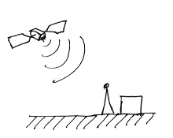
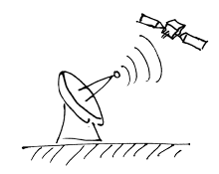
Control Segment
A master control station (MCS)
An alternative master control station
Four dedicated ground antennas
Six dedicated monitor stations

Slide 6
User Segment
The user segment (US) is composed of hundreds of thousands of U.S. and allied military users of the secure GPS Precise Positioning Service, and tens of millions of civil, commercial and scientific users of the Standard Positioning Service.
In general, GPS receivers are composed of an antenna, tuned to the frequencies transmitted by the satellites, receiver-processors, and a highly stable clock (often a crystal oscillator).

Slide 7

Applications of GPS
Distance measurement
Time Synchronization
Industrial Economy
Military and Defence
Scientific Experimentation
Geographical Observation
Public Safety & Disaster Relief

Slide 8
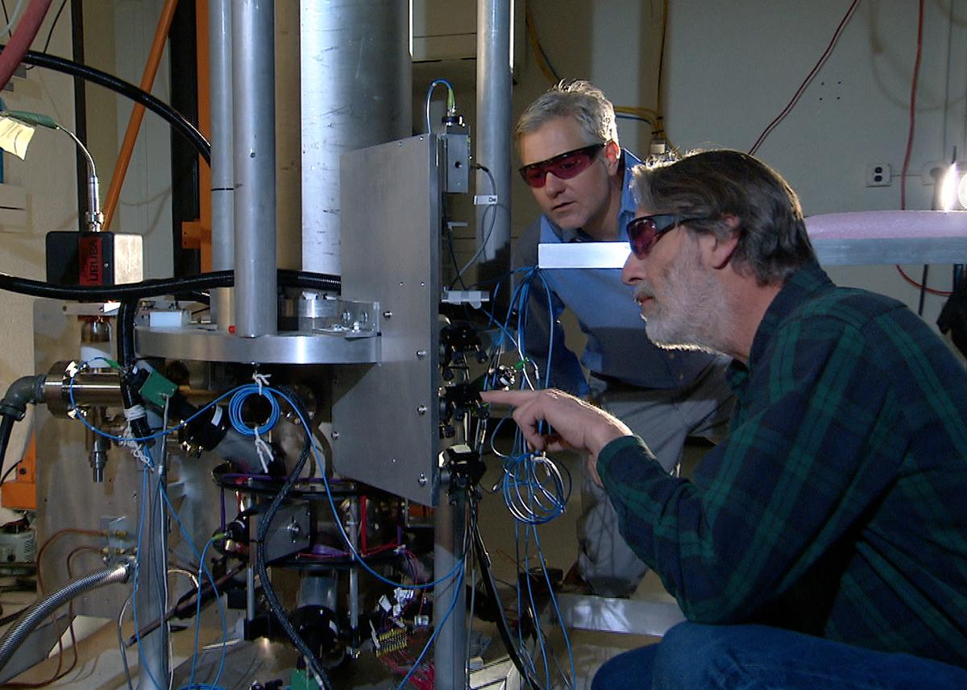
Time Synchronization with GPS
Each GPS satellite contains multiple atomic clocks that contribute very precise time data to the GPS signals.
GPS receivers decode these signals, effectively synchronizing each receiver to the atomic clocks.
This enables users to determine the time to within 100 billionths of a second, without the cost of owning and operating atomic clocks.

Slide 9
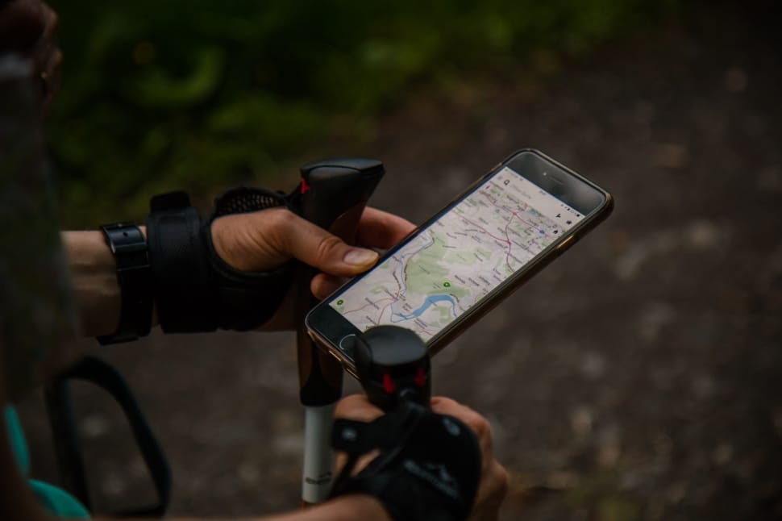
Under The Hood

Slide 10
Working of Satellite Constellation
Position fix is obtained in passive receivers by the triangulation method
Estimated ranges from four satellites are used to derive the position and altitude of a point.
Ranges from three satellites can provide the latitude and longitude of a point on the Earth
The addition of a fourth satellite can provide a user’s altitude and correct receiver clock error.
GPS constellation system

Slide 11
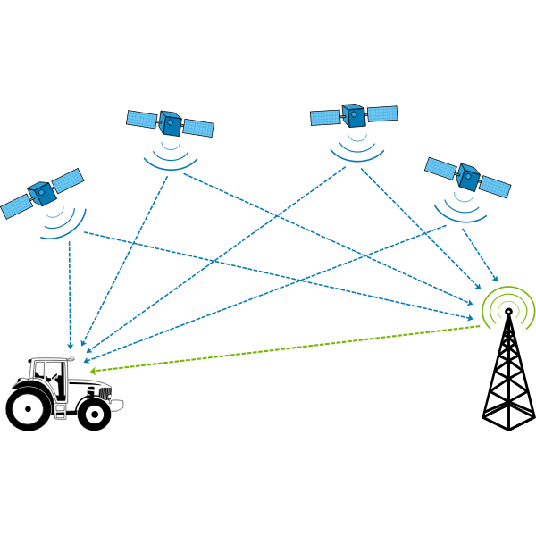
Trilateration — a.k.a. True-range multilateration
It is a method to determine the location of a movable vehicle or stationary point in space using multiple ranges between the vehicle/point and multiple spatially-separated known locations.

Slide 12
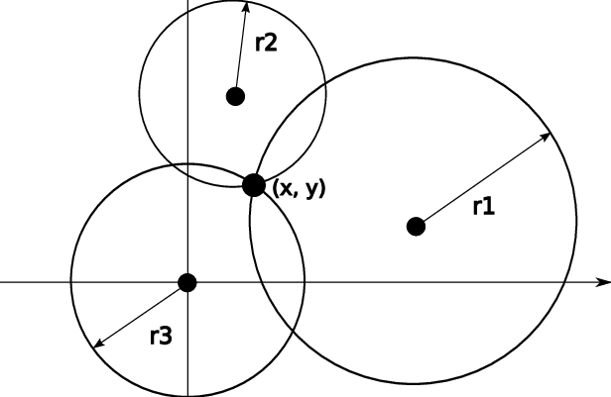
Trilateration (2D)
On a plane, if we know our distance from three points, we know exactly where we are.
Let us say that we are 10 miles away from point A, 12 miles away from point B, and 15 miles away from point C.
If we draw three circles with the centers at A, B, and C, we must be somewhere on circle A, somewhere on circle B, and somewhere on circle C.
These three circles meet at one single point (if our distances are correct), our position.

Slide 13
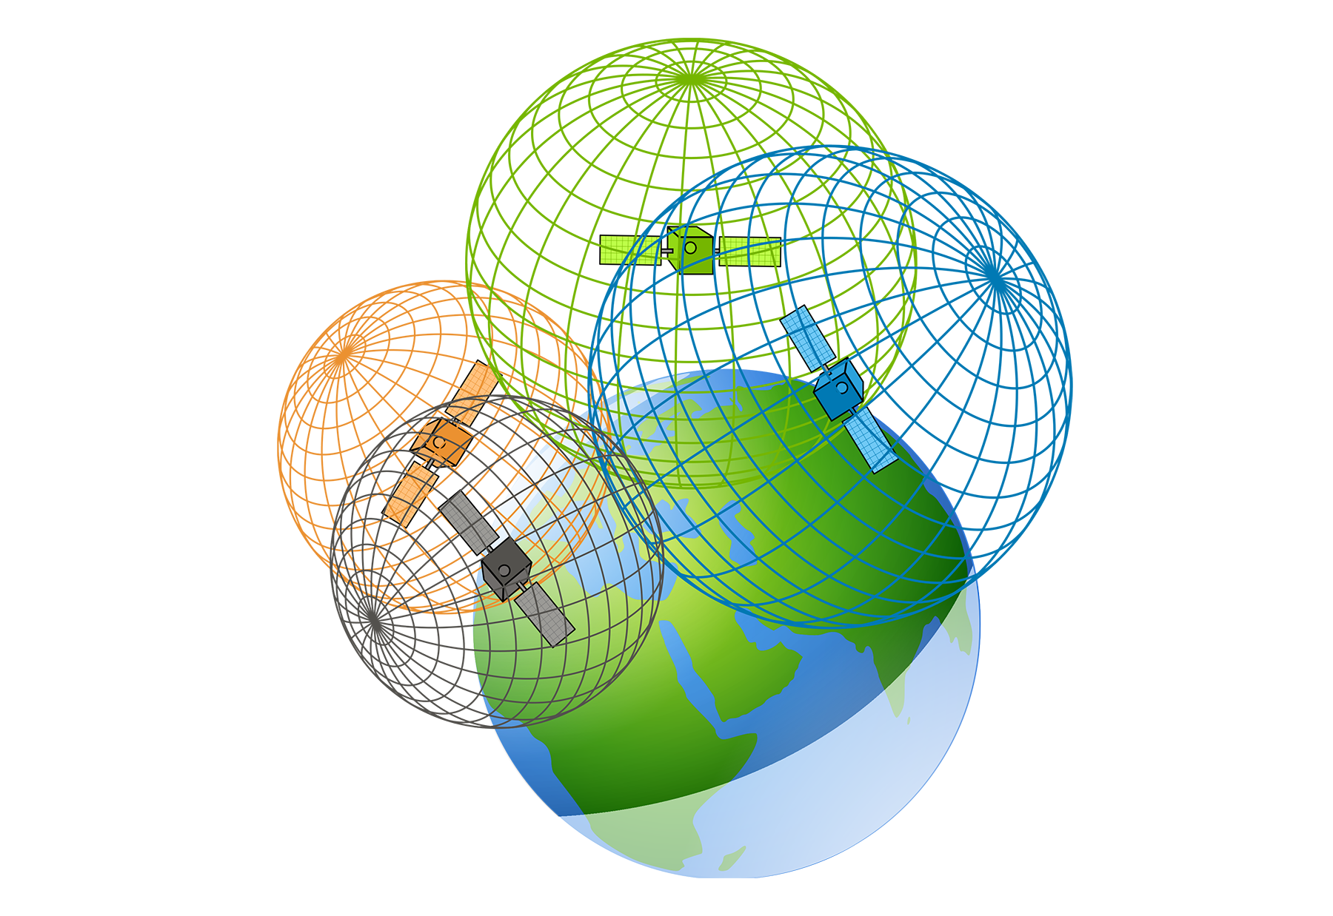
3D - Trilateration
In three-dimensional space, we need at least four spheres to find our exact position in space, i.e., longitude, latitude, and altitude.
However, if we have additional facts about our location (for example, we know that we are not inside the ocean or somewhere in space), three spheres are enough, because one of the two points, where the spheres meet, is so improbable that the other can be selected without a doubt.

Slide 14
Measuring Distance with GPS
The position of each satellite can be calculated by a GPS receiver (using the predetermined path of the satellites).
The GPS receiver, needs to find its distance from at least three GPS satellites (center of the spheres).
The distance is measured using a principle called one-way ranging
Each of 24 satellites synchronously transmits a complex signal each having a unique pattern.
The receiver measures the delay between the signals and its copy of signals to determine the distances to the satellites.

Slide 15
Synchronization with GPS
Satellites use atomic clock (costs more that $50,000)
Offset b/w the satellite clocks & the receiver clock creates inaccuracy
Due to Theory of Relativity (same for all Satellites)
The strontium atomic clock is accurate to within 1/15,000,000,000 of a second per year.
We need to find the coordinates of receiver (Xp, Yp, Zp) & common clock offset dt

Slide 16




Synchronization with GPS
Four unknown values, Four equations for each satellite’s connection.
These coordinates are in an Earth-Centered Earth-Fixed (ECEF) reference frame
The ECEF coordinates of a fixed point on the surface of the earth do not change

Slide 17
Global Navigation Satellite System (GNSS)
GNSS is a general term describing any satellite constellation that provides positioning, navigation, and timing (PNT) services on a global or regional basis.
While GPS is the most prevalent GNSS, other nations are fielding, or have fielded, their own systems to provide complementary, independent PNT capability. The main ones are described below.
GNSS can also refer to augmentation systems, but there are too many international augmentations to list here.

Slide 18
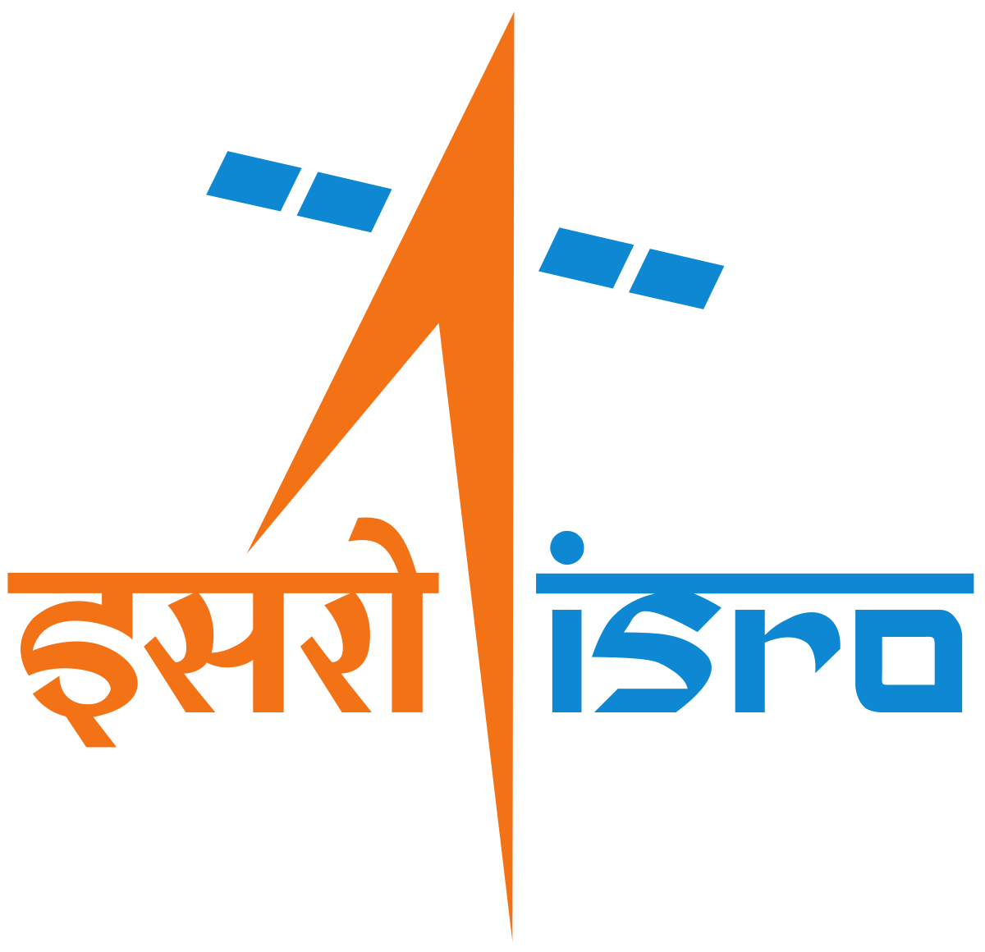
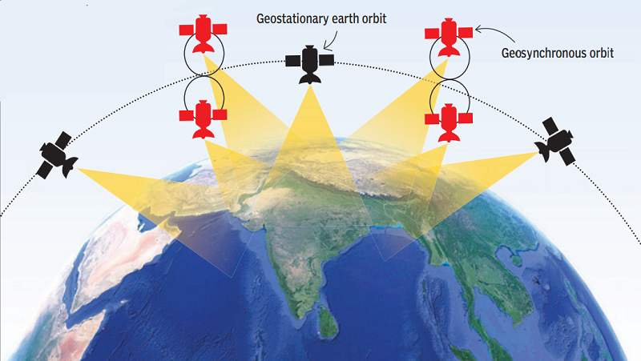
Indian Regional Navigation Satellite System (IRNSS)
Navigation Indian Constellation (NavIC)
IRNSS is a regional GNSS owned and operated by the Government of India. IRNSS is an autonomous system designed to cover the Indian region and 1500 km around the Indian mainland. The system consists of 7 satellites. In 2016, India renamed IRNSS as the Navigation Indian Constellation (NavIC, meaning "sailor" or "navigator").

Slide 19

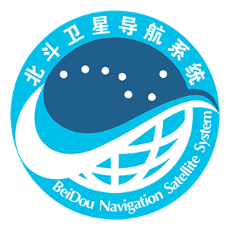
BeiDou Navigation Satellite System (BDS)
Galileo
Galileo is a global GNSS owned and operated by the European Union. The EU declared the start of Galileo Initial Services in 2016 and plans to complete the system of 24+ satellites in 2021.
BeiDou, or BDS, is a global GNSS owned and operated by the People's Republic of China. BDS was formally commissioned in 2020. The operational system consists of 35 satellites. BDS was previously called Compass.

Slide 20
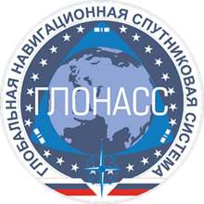
Quasi-Zenith Satellite System (QZSS)
GLONASS
QZSS is a regional GNSS owned by the Government of Japan and operated by QZS System Service Inc. (QSS). QZSS complements GPS to improve coverage in East Asia and Oceania. Japan declared the official start of QZSS services in 2018 with 4 operational satellites, and plans to expand the constellation to 7 satellites by 2023 for autonomous capability.
GLONASS (Globalnaya Navigazionnaya Sputnikovaya Sistema, or Global Navigation Satellite System) is a global GNSS owned and operated by the Russian Federation. The fully operational system consists of 24+ satellites.

Slide 21
References
GPS.gov USA - https://www.gps.gov/
Encyclopedia Britannica - https://www.britannica.com/technology/GPS
Wikipedia - https://en.wikipedia.org/wiki/Global_Positioning_System
Data Communications and Networking By Behrouz A. Forouzan
Mobile Satellite Communications By Richharia Madhavendra

